Slide 1


KETHOLESHIIDA… DIETHERIEKO
Ketholeshiida … Dietherieko kezhakesu, Kijiipete Krothoko Fort Worth, Texas
©2006 TBBMI
Designed by Dr. John Fryman, Texas, USA • BibleBasically.org
Taught by Dr. Rick Griffith, Singapore Bible College
All files in many languages for free download at BibleStudyDownloads.org
www.biblebasically.com
©2006 TBBMI

Slide 2


(Siri Thechu Kira Ba?)
KETHOLESHUDA… DIETHERIKO
ZA KENIE
UTHA CHUKETSO KECHU: THIEDZU NIATHUTSA KIJU MHIERHI CHUKECHU
02
©2006 TBBMI
9.6.01.

Slide 3
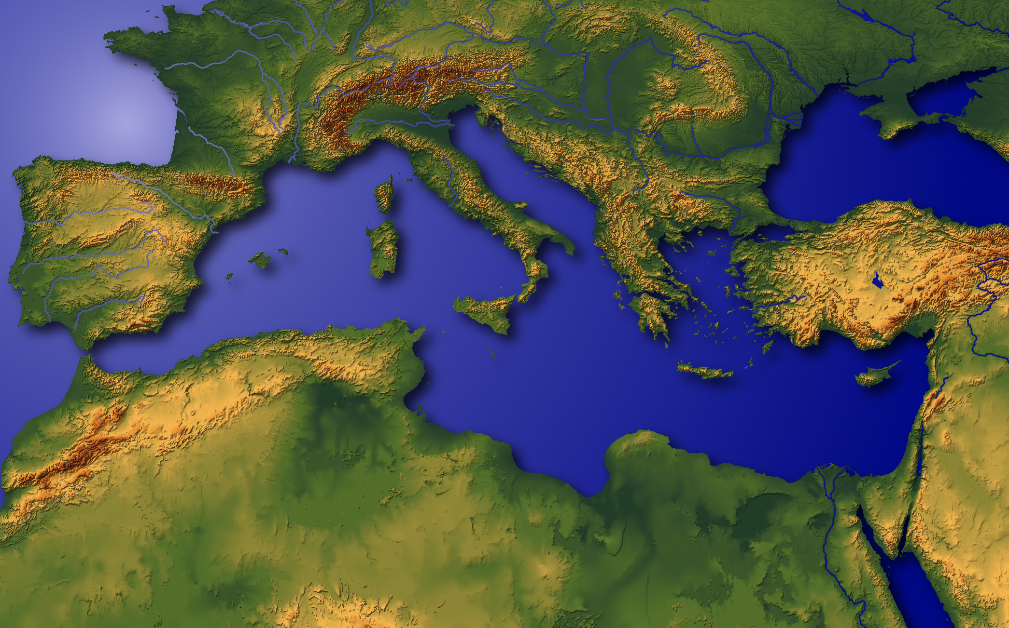
UTHA
CHUKETSO
KECHU
?
Mediterranean Thanu Ketholeshu Dako Mhatho
4
03
4
9.6.02.
© 2006 TBBMI
03

Slide 4
UTHA
CHUKETSO
KECHU
Mediterranean Dzukezha
LEBANON
SIRIA
Haifa
Galil Zie
IRAQ
Nazaret
Netanya
Tel Aviv-Jaffa
AMMAN
JERUSALEM
Jeriko
Gaza
Hebron
Kesia Zie
Beersheba
ISRAEL
JORDAN
IJIPT
SAUDI ARABIA
Eilat
Gulf of Aqaba
Al’ Aqaba
04
1

Slide 5
UTHA
CHUKETSO
KECHU
MD
N(A)
H
GZ
C
ER
B
J
NK
DS
E
KB
U
KIJU MHIERHI PUOCAKO!
SK
PG
KD
Leshuda Puolha 15-16
1
05

Slide 6
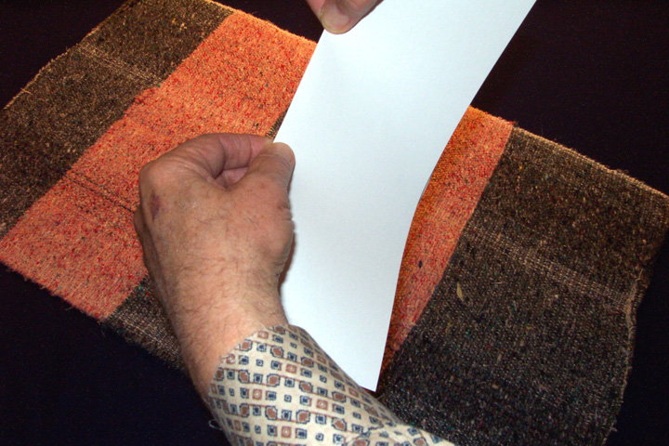
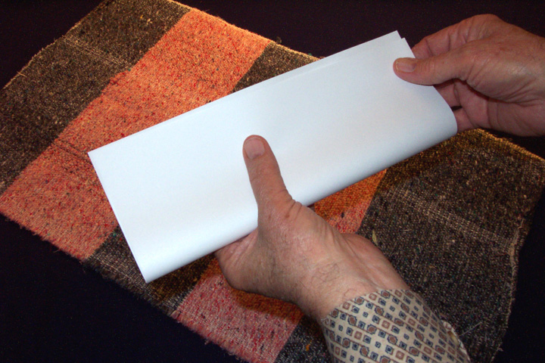
KEPHRU KEKROHI #03a; (leshuda peshakeba #03b)
Leshu Puo
Pielie
Sie
Vapou
Pedou Di,
Kekhrie
Shulie
UTHA
CHUKETSO
KECHU
Leshuda Puolha 15-16
06

Slide 7
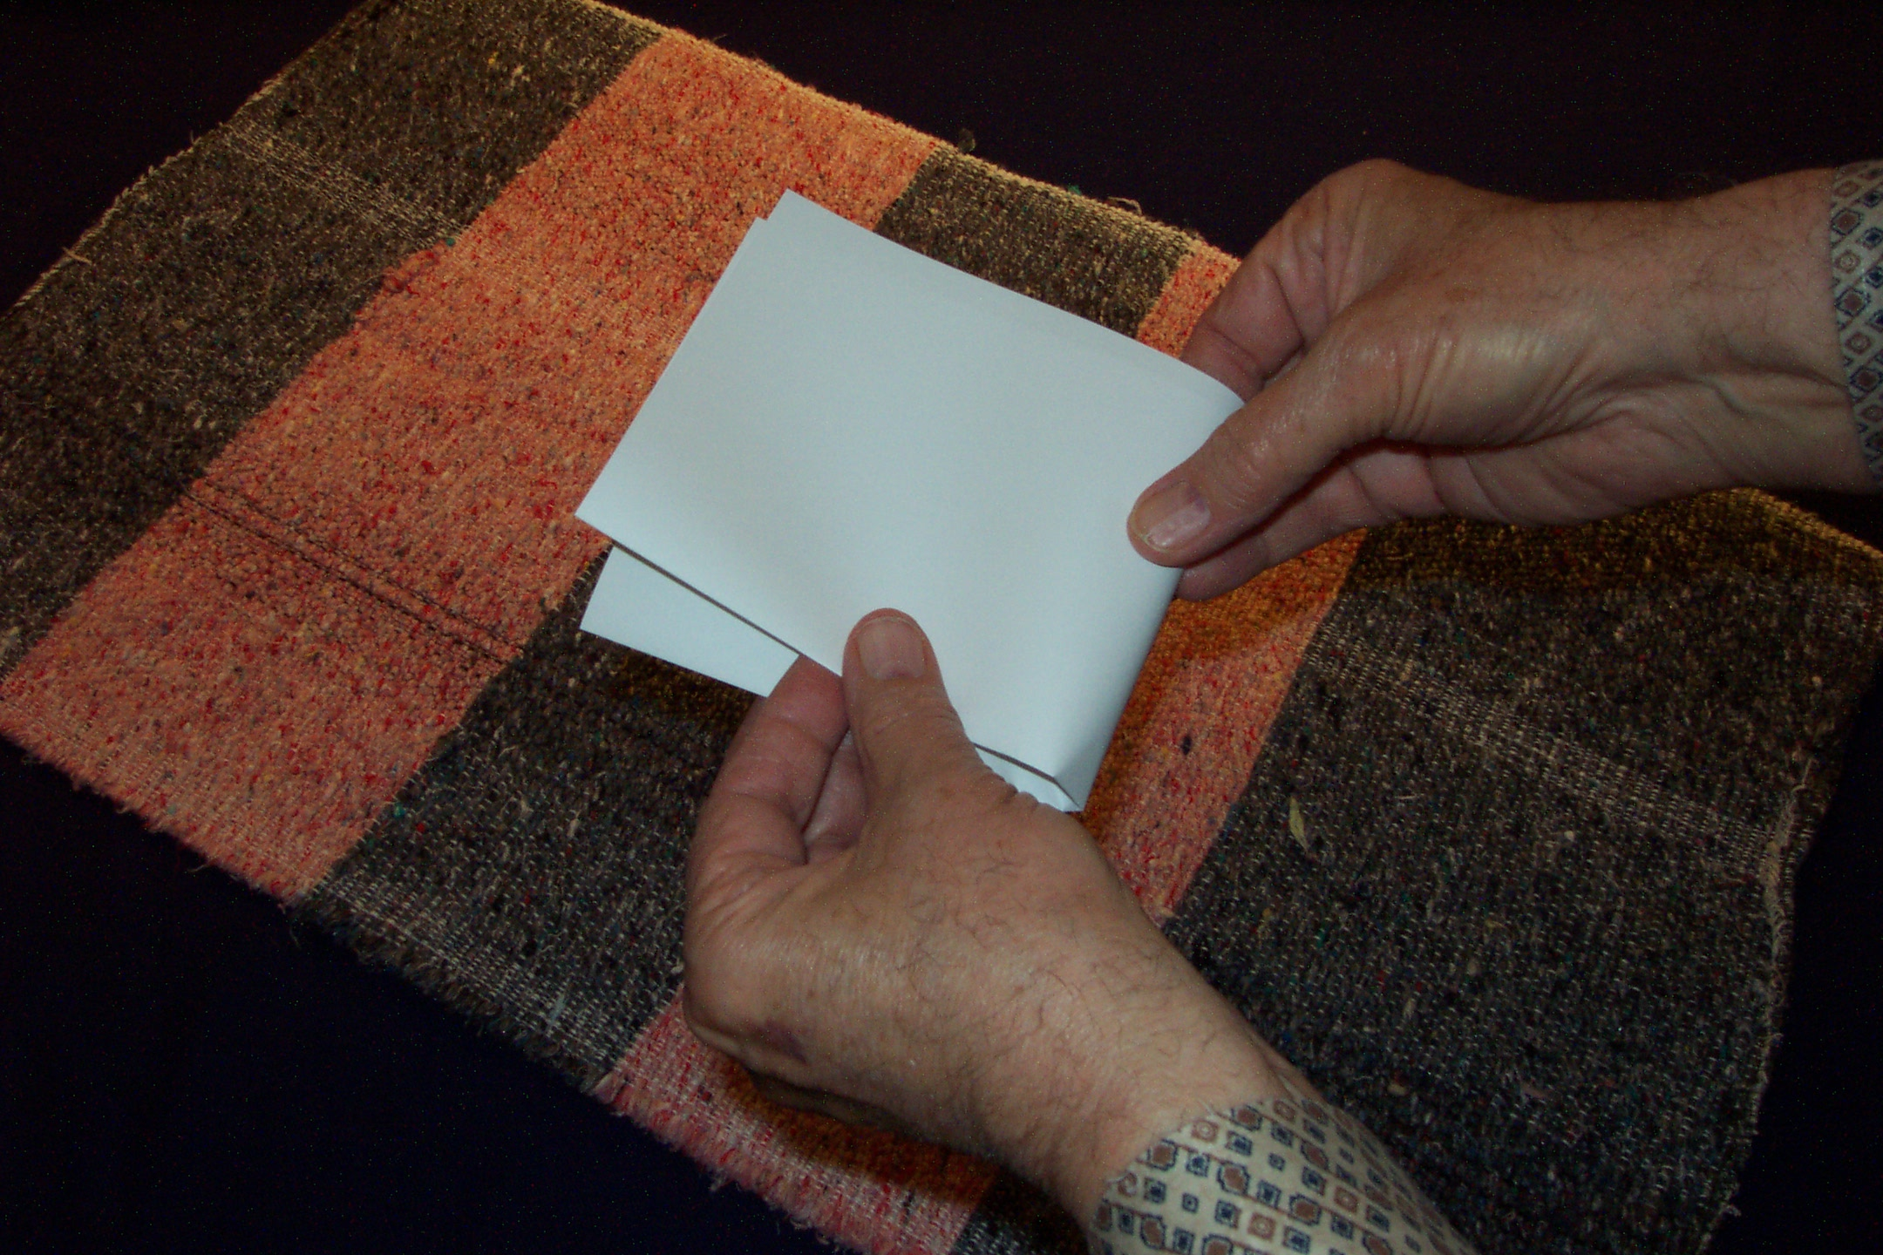
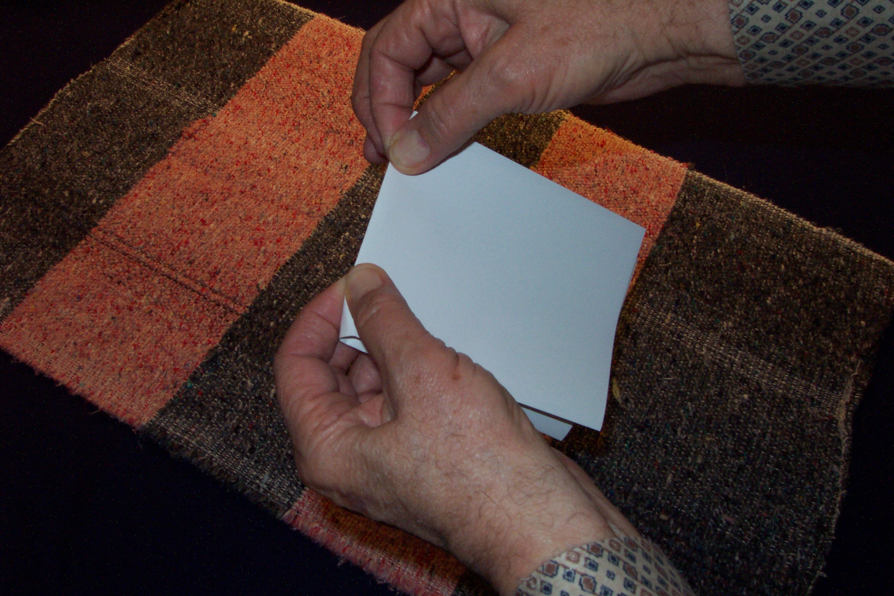
UTHA
CHUKETSO
KECHU
DRESSING
THE
STAGE
Vapuo Kekhrie
Lashu lie…
…Cha Kenie Chuketuo La
Leshuda Puolha 15-16
07

Slide 8
UTHA
CHUKETSO
KECHU
DRESSING
THE
STAGE
Leshuda Puolha 15-16
08
3

Slide 9
UTHA
CHUKETSO
KECHU
DRESSING
THE
STAGE
KEREIU: DZURULA 6
KENIEU: KIJU THECHU 10
VASEU: KEPETSE KEMEHO
Leshuda Puolha 15-16
09
2

Slide 10
UTHA
CHUKETSO
KECHU
DRESSING
THE
STAGE
Leshuda Puolha 15-16
10
1

Slide 11
UTHA
CHUKETSO
KECHU
DRESSING
THE
STAGE
Leshuda Puolha 15-16
11

Slide 12
UTHA
CHUKETSO
KECHU
DRESSING
THE
STAGE
THECHU ZA KO SEHIE...
HAYO RUBEI SELIE
LESHU THUKERIEU PUOZAKO...
DIE CA PETEKO SEHIE!
Leshuda Puolha 15-16
12

Slide 13
UTHA
CHUKETSO
KECHU
DRESSING
THE
STAGE
MD
Leshuda Puolha 15-16
13

Slide 14
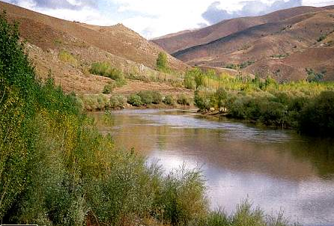
UTHA
CHUKETSO
KECHU
DRESSING
THE
STAGE
MD
ER
Leshuda Puolha 15-16
14

Slide 15

UTHA
CHUKETSO
KECHU
DRESSING
THE
STAGE
MD
ER
PG
Leshuda Puolha 15-16
15

Slide 16
UTHA
CHUKETSO
KECHU
DRESSING
THE
STAGE
MD
MEDITERRANEAN DZUKEZHA
ED
EUPHRATES RU
PG
PERSIAN GULF
Leshuda Puolha 15-16
16
2

Slide 17
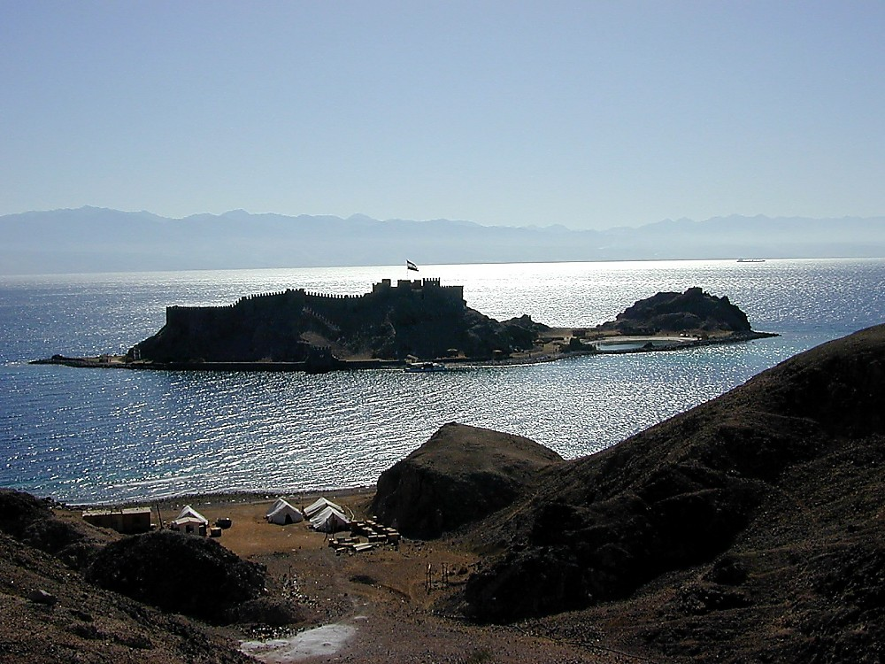

UTHA
CHUKETSO
KECHU
DRESSING
THE
STAGE
MD
ER
PG
Leshuda Puolha 15-16
17

Slide 18
UTHA
CHUKETSO
KECHU
DRESSING
THE
STAGE
MD
ER
KEMERIE ZIE
PG
KZ
Leshuda Puolha 15-16
18

Slide 19
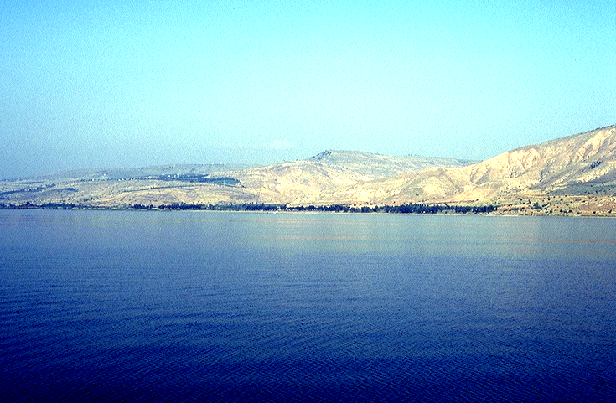
UTHA
CHUKETSO
KECHU
DRESSING
THE
STAGE
MD
ER
PG
KZ
Leshuda Puolha 15-16
19

Slide 20
UTHA
CHUKETSO
KECHU
DRESSING
THE
STAGE
MD
ER
PG
KZ
Leshuda Puolha 15-16
20

Slide 21
UTHA
CHUKETSO
KECHU
DRESSING
THE
STAGE
MD
GZ
GALIL ZIE
ER
PG
KZ
Leshuda Puolha 15-16
21

Slide 22
UTHA
CHUKETSO
KECHU
DRESSING
THE
STAGE
MD
GZ
GALIL ZIE
ER
KD
KESIA DZUKEZHA
PG
KZ
Leshuda Puolha 15-16
22

Slide 23
UTHA
CHUKETSO
KECHU
DRESSING
THE
STAGE
MD
GZ
ER
KD
JORDAN RU
PG
KZ
Leshuda Puolha 15-16
23

Slide 24
UTHA
CHUKETSO
KECHU
DRESSING
THE
STAGE
6
MD
GZ
ER
KD
PG
KZ
DZURULA
Leshuda Puolha. 15-16
7
24

Slide 25

UTHA
CHUKETSO
KECHU
DRESSING
THE
STAGE
MS
SG
ER
“KIJU KO”
DS
PG
RS
Leshuda Puolha 15-16
25
1

Slide 26
UTHA
CHUKETSO
KECHU
DRESSING
THE
STAGE
THECHU 10
10
MD
GZ
ER
KD
KIJU THECHU
PG
KZ
Leshuda Puolha 15-16
26
1

Slide 27
UTHA
CHUKETSO
KECHU
DRESSING
THE
STAGE
THECHU 10
MD
4
GZ
ER
KD
PG
KZ
Leshuda Puolha 15-16
27

Slide 28
UTHA
CHUKETSO
KECHU
DRESSING
THE
STAGE
THECHU 10
MD
6
4
GZ
ER
KD
Ketholeshudako “Mhatho Uthako”
PG
KZ
Leshuda Puolha 15-16
28

Slide 29
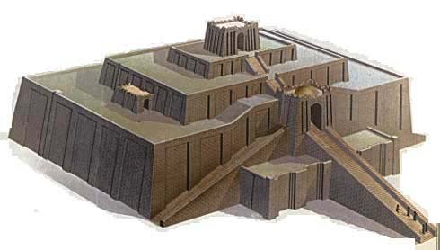
UTHA
CHUKETSO
KECHU
DRESSING
THE
STAGE
THECHU 10
MD
6
4
SG
ER
DS
U
PG
UR , CHALDEES NU
RS
Leshuda Puolha 15-16
29

Slide 30

UTHA
CHUKETSO
KECHU
DRESSING
THE
STAGE
THECHU 10
MD
6
4
GZ
ER
B
KD
U
BABILON
PG
KZ
Leshuda Puolha. 15-16
30

Slide 31

UTHA
CHUKETSO
KECHU
DRESSING
THE
STAGE
THECHU 10
MD
6
4
H
GZ
ER
B
KD
U
HARAN
PG
(HARRAN,TURKEY)
KZ
Leshuda Puolha 15-16
31

Slide 32
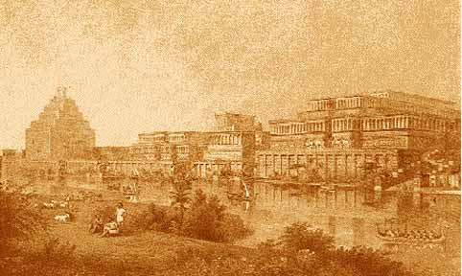
UTHA
CHUKETSO
KECHU
DRESSING
THE
STAGE
THECHU 10
MD
6
4
N(A)
H
GZ
ER
B
KD
NINEVI
(ASSYRIA) MOSUL, IRAQ
U
PG
KZ
Leshuda Puolha 15-16
32

Slide 33
UTHA
CHUKETSO
KECHU
DRESSING
THE
STAGE
THECHU 10
MD
6
4
N(A)
H
GZ
ER
B
KD
U
PG
KZ
Leshuda Puolha 15-16
33

Slide 34
UTHA
CHUKETSO
KECHU
DRESSING
THE
STAGE
THECHU 10
MD
6
4
N(A)
H
TSEIDO KANAN
K
GZ
ER
B
KD
U
PG
KZ
Leshuda Puolha 15-16
34
1

Slide 35
DRESSING
THE
STAGE
UTHA
CHUKETSO
KECHU
THECHU 10
MD
6
4
N(A)
H
GZ
K
JERUSALEM
ER
J
B
KD
U
PG
KZ
Leshuda Puolha 15-16
35

Slide 36
UTHA
CHUKETSO
KECHU
DRESSING
THE
STAGE
THECHU 10
MD
6
4
N(A)
H
GZ
K
ER
NK
B
J
NEBO KIJUTHOU
KD
U
PG
KZ
Leshuda Puolha 15-16
36

Slide 37

UTHA
CHUKETSO
KECHU
DRESSING
THE
STAGE
THECHU 10
MD
6
4
N(A)
H
KADESH BARNEA
GZ
K
ER
B
J
NK
KD
KB
U
PG
KZ
Leshuda Puolha 15-16
37

Slide 38
UTHA
CHUKETSO
KECHU
DRESSING
THE
STAGE
THECHU 10
MD
6
4
N(A)
H
IJIPT: Gaza Kijuthou
GZ
K
ER
B
J
NK
KD
I
KB
U
PG
KZ
Leshuda Puolha 15-16
38

Slide 39
UTHA
CHUKETSO
KECHU
THECHU 10
MD
6
4
N(A)
H
SINAI KIJUTHOU
GZ
K
ER
B
J
NK
KD
I
KB
U
SK
PG
KZ
Leshuda Puolha 15-16
39

Slide 40
UTHA
CHUKETSO
KECHU
DRESSING
THE
STAGE
THECHU 10
MD
6
4
10
KIJU THECHU
N(A)
H
GZ
K
ER
B
J
NK
KD
I
KB
U
SK
PG
KZ
Leshuda Puolha 15-16
40
2

Slide 41
Chapimiako 20:1; 2 Sam 17:11; Kediko Kerieu 4:25
UTHA
CHUKETSO
KECHU
THECHU 10
MD
6
4
N(A)
“DAN
VO
BEERSHEBA
KETSO”
H
KIJU KO
GZ
C
ER
B
J
NK
KD
I
KB
U
SK
PG
KZ
Leshuda Puolha 15-16
41
3

Slide 42
UTHA
CHUKETSO
KECHU
DRESSING
THE
STAGE
MD
N(A)
H
GZ
K
ER
B
J
NK
“Mhatho
Uthako!”
KZ
I
KB
U
SK
PG
KZ
Leshuda Puolha 15-16
42

Slide 43
UTHA
CHUKETSO
KECHU
DRESSING
THE
STAGE
TSIE… MHA MEHO LAKESHU...
Leshuda Puolha 15-16
43

Slide 44
UTHA
CHUKETSO
KECHU
DRESSING
THE
STAGE
Leshuda Puolha 15-16
44

Slide 45
UTHA
CHUKETSO
KECHU
DRESSING
THE
STAGE
Leshuda Puolha 15-16
45

Slide 46
UTHA
CHUKETSO
KECHU
DRESSING
THE
STAGE
Leshuda Puolha 15-16
46

Slide 47
UTHA
CHUKETSO
KECHU
UTHA
CHUKETSO
KECHU
DRESSING
THE
STAGE
Leshuda Puolha 15-16
47

Slide 48
UTHA
CHUKETSO
KECHU
DRESSING
THE
STAGE
MD
Leshuda Puolha 15-16
48

Slide 49
UTHA
CHUKETSO
KECHU
DRESSING
THE
STAGE
MD
ER
Leshuda Puolha 15-16
49

Slide 50
UTHA
CHUKETSO
KECHU
DRESSING
THE
STAGE
MD
ER
PG
Leshuda Puolha 15-16
50

Slide 51
UTHA
CHUKETSO
KECHU
DRESSING
THE
STAGE
MD
(MEDITERRANEAN DZUKEZHA)
ER
(EUPHRATES RU)
PG
(PERSIAN GULF)
Leshuda Puolha 15-16
51

Slide 52
UTHA
CHUKETSO
KECHU
DRESSING
THE
STAGE
MD
ER
PG
Leshuda Puolha 15-16
52

Slide 53
UTHA
CHUKETSO
KECHU
DRESSING
THE
STAGE
MD
ER
PG
KZ
Leshuda Puolha 15-16
53

Slide 54
UTHA
CHUKETSO
KECHU
DRESSING
THE
STAGE
MD
ER
PG
KZ
Leshuda Puolha 15-16
54

Slide 55
UTHA
CHUKETSO
KECHU
DRESSING
THE
STAGE
MD
ER
PG
KZ
Leshuda Puolha 15-16
55

Slide 56
UTHA
CHUKETSO
KECHU
DRESSING
THE
STAGE
MD
ER
PG
KZ
Leshuda Puolha 15-16
56

Slide 57
UTHA
CHUKETSO
KECHU
DRESSING
THE
STAGE
MD
GZ
ER
PG
KZ
Leshuda Puolha 15-16
57

Slide 58
UTHA
CHUKETSO
KECHU
DRESSING
THE
STAGE
MD
GZ
ER
KD
PG
KZ
Leshuda Puolha 15-16
58

Slide 59
UTHA
CHUKETSO
KECHU
DRESSING
THE
STAGE
MD
GZ
ER
JORDAN RU
KD
PG
KZ
Leshuda Puolha 15-16
59
1

Slide 60
UTHA
CHUKETSO
KECHU
DRESSING
THE
STAGE
THECHU 10
MD
GZ
ER
KD
PG
KZ
Leshuda Puolha 15-16
60

Slide 61
UTHA
CHUKETSO
KECHU
DRESSING
THE
STAGE
THECHU 10
MD
4
GZ
ER
KD
PG
KZ
Leshuda Puolha 15-16
61

Slide 62
UTHA
CHUKETSO
KECHU
THECHU 10
MD
6
4
GZ
ER
KD
PG
KZ
Leshuda Puolha 15-16
62

Slide 63
UTHA
CHUKETSO
KECHU
THECHU 10
MD
6
4
GZ
ER
KD
U
PG
KZ
Leshuda Puolha 15-16
63

Slide 64
UTHA
CHUKETSO
KECHU
DRESSING
THE
STAGE
THECHU 10
MD
6
4
GZ
ER
B
KD
U
PG
KZ
Leshuda Puolha 15-16
64

Slide 65
UTHA
CHUKETSO
KECHU
DRESSING
THE
STAGE
THECHU 10
MD
6
4
H
GZ
ER
B
KD
U
PG
KZ
Leshuda Puolha 15-16
65

Slide 66
UTHA
CHUKETSO
KECHU
THECHU 10
MD
6
4
N(A)
H
GZ
ER
B
KD
U
PG
KZ
Leshuda Puolha 15-16
66

Slide 67
UTHA
CHUKETSO
KECHU
THECHU 10
MD
6
4
N(A)
H
GZ
ER
B
KD
U
PG
KZ
Leshuda Puolha 15-16
67

Slide 68
UTHA
CHUKETSO
KECHU
THECHU 10
MD
6
4
N(A)
H
K
GZ
ER
B
KD
U
PG
KZ
Leshuda Puolha 15-16
68

Slide 69
UTHA
CHUKETSO
KECHU
DRESSING
THE
STAGE
THECHU 10
MD
6
4
N(A)
H
GZ
K
ER
J
B
KD
U
PG
KZ
Leshuda Puolha 15-16
69

Slide 70
UTHA
CHUKETSO
KECHU
THECHU 10
MD
6
4
N(A)
H
GZ
K
ER
NK
B
J
KD
U
PG
KZ
Leshuda Puolha 15-16
70

Slide 71
UTHA
CHUKETSO
KECHU
DRESSING
THE
STAGE
THECHU 10
MD
6
4
N(A)
H
GZ
K
ER
B
J
NK
KD
KB
U
PG
KZ
Leshuda Puolha 15-16
71

Slide 72
UTHA
CHUKETSO
KECHU
DRESSING
THE
STAGE
THECHU 10
MD
6
4
N(A)
H
GZ
K
ER
B
J
NK
KD
I
KB
U
PG
KZ
Leshuda Puolha 15-16
72

Slide 73
UTHA
CHUKETSO
KECHU
THECHU 10
MD
6
4
N(A)
H
GZ
K
ER
B
J
NK
KD
I
KB
U
SK
PG
KZ
Leshuda Puolha 15-16
73

Slide 74
UTHA
CHUKETSO
KECHU
THECHU 10
MD
6
4
N(A)
H
GZ
K
ER
B
J
NK
KD
I
KB
U
SK
PG
KZ
Leshuda Puolha 15-16
74
1

Slide 75
UTHA
CHUKETSO
KECHU
THECHU 10
MD
6
4
N(A)
H
KIJU KO
GZ
K
ER
B
J
NK
KD
“DAN
VO
BEERSHEBA KETSO ”
I
KB
U
SK
PG
Chapimiako 20:1
KZ
Leshuda Puolha 15-16
75

Slide 76
UTHA
CHUKETSO
KECHU
MD
N(A)
H
GZ
K
ER
B
J
NK
“Mhatho
Uthako!”
KD
I
KB
U
SK
PG
KZ
Leshuda Puolha 15-16
76

Slide 77
UTHA
CHUKETSO
KECHU
DRESSING
THE
STAGE
TSIE PUOCA HAKO PETE LA LIRO...
Leshuda Puolha 15-16
77

Slide 78
UTHA
CHUKETSO
KECHU
Pesotsa Kiju Kemene Nu Vo
Pekhrotsa Keso Ketso…
Leshuda Puolha 15-16
78

Slide 79
UTHA
CHUKETSO
KECHU
DRESSING
THE
STAGE
MD
N(A)
H
GZ
K
ER
B
J
NK
KD
…nieko kelie mhi nunu “Utha Chuketso tuo” Ketholeshuda do chulie ketuo la!
I
KB
U
SK
PG
KZ
Leshuda Puolha 15-16
79
1

Slide 80
UTHA
CHUKETSO
KECHU
MD
PELHOUKESHU
N(A)
ABRAHAM
H
JOSEF
MOSA
GZ
K
JOSHUA
ER
ULAKRIKO
B
J
NK
KEDIMIAKO
KD
MIADIA KECHU
I
ZIKETA
KB
JESU
U
SK
PG
KZ
Leshuda Puolha 15-16
80

Slide 81
UTHA
CHUKETSO
KECHU
DRESSING
THE
STAGE
TSIE N MESETE…
THIEDZU NIATHUTSA KIJU MIARHI N CU NUNU CHULIECIE
KEPHRU KEKROHI NUNU KIJU MIARHI TSILETE #30
Leshuda Puolha 15-16
81

Slide 82

Tsie Ketholeshuda… Dietherieko nkele nu bate …
•Ndo Hau Liro “Ketholeshu Da”
•N Mhale Nu Khrushuketou Cabi “Ketholeshu Da”…P7KJ
• Kele Miarhi Nu Ketholeshuda Nu Mhatho Kemeyie Voketako Pfukechu.
• Ketholeshu “DZE” Kesouko: “Nuose Nuoyie Mhaketa”
1
82

Slide 83
UTHA
CHUKETSO
KECHU
Nuose Nuoyie Mhaketa
“No Kehoupuo Chusierei , Thechu Kira Bashi Silietuo!”
“Derie, Thechu Kerapuo Ba Ga?”
Leshuda Puolha 15-16
1
83

Slide 84
KETHOLESHUDA…
DEITHERIEKO
Ketholeshu Dze Dietherieko kezhakesu… Kijupete Krothoko Fort Worth, Texas
www.biblebasically.org
©2006TBBMI
9.6.02.
84
Notes:
PLEASE PUT THE TITLE AND SUBTITLES INTO YOUR NATIONAL LANGUAGE AND LEAVE THE WEBSITE UNCHANGED

Slide 85


Ketholeshiida…Dietherieko • BibleStudyDownloads.org
Get this presentation for free!
Notes:
The Bible…Basically (bb)

Slide 86
85
©2006 TBBMI
9.6.02.

